Slide 1



St. Francis - InterQuest
{Distributor Logo}
Notes:
{Everything in brackets { … } is to be set up BEFORE going into the meeting.

Slide 2
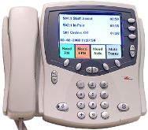
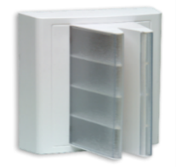
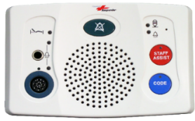
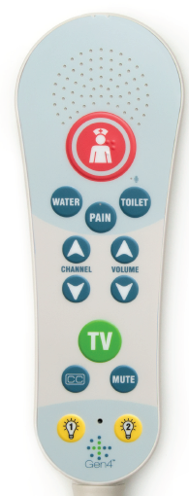
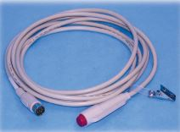
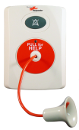
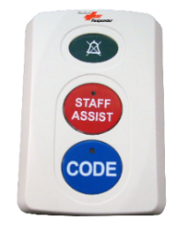
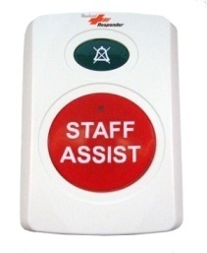
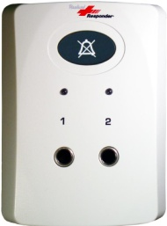
Device Overview
Nurse Console
Dome/Zone
Light
Enhanced Patient
Station
Pillow Speaker
Call Cord
Pull Cord
2-Button
Staff Assist
Device
Duty Station
2-Jack
Feature Bed Interface

Slide 3
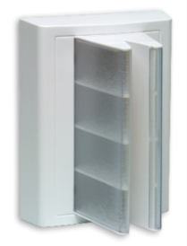


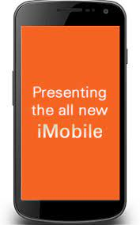

Patient Call
Corridor Light Display:
Flashing white light in segment 1 above the patient’s door.
Console will ring
after 1 minute(when delay
button is activated).
Tone Type:
Slow Ding
To Cancel Call:
Answer call
Enter room with badge
Press cancel button
CNA
RN
NC
30 secs
30 secs
Call Stop 1
Call Stop 2

Slide 4
Pain Call
Corridor Light Display:
Flashing white and green lights in segments 1 and 2 above the patient’s door.
Console will ring
after 1 minute(when delay
button is activated).
Tone Type:
Slow Ding
To Cancel Call:
Answer call
Enter room with badge
Press cancel button
CNA
RN
NC
30 secs
30 secs
Call Stop 1
Call Stop 2

Slide 5
Water Call
Corridor Light Display:
Flashing white and orange lights in segments 1 and 2 above the patient’s door.
Console will ring
after 1 minute(when delay
button is activated).
Tone Type:
Slow Ding
To Cancel Call:
Answer call
Enter room with badge
Press cancel button
CNA
RN
NC
30 secs
30 secs
Call Stop 1
Call Stop 2

Slide 6
Toilet Assist Call
Corridor Light Display:
Flashing white and red and orange lights in segments 1 and 2 and 3 above the patient’s door.
Console will ring
after 1 minute(when delay
button is activated).
Tone Type:
Slow Ding
To Cancel Call:
Answer call
Enter room with badge
Press cancel button
CNA
RN
NC
30 secs
30 secs
Call Stop 1
Call Stop 2

Slide 7
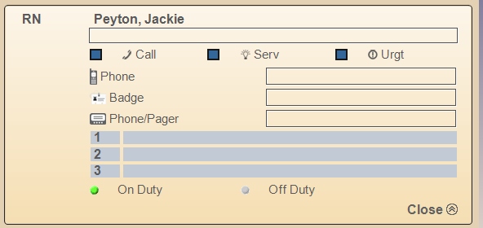
Toilet/ Shower Emergency
Corridor Light Display:
Flashing Red lights in segments 3 and 4 above the patient’s door.
Console will ring
immediately.
Tone Type:
Fast Ding
To Cancel Call:
Press cancel button
Urgent Call Option: (This is an option to receive all urgent calls from all rooms.)
(Uncheck box to receive urgent calls from your rooms only.)

Slide 8

Bed Exit
Corridor Light Display:
Cascading yellow lights in all 4 segments above the patient’s door.
Tone Type:
Fast Ding
Console will ring
immediately.
To Cancel Call:
Press cancel button
Urgent Call Option: (This is an option to receive all urgent calls from all rooms.)
(Uncheck box to receive urgent calls from your rooms only.)

Slide 9
Chair Alarm
Corridor Light Display:
Cascading yellow lights in all 4 segments above the patient’s door.
Tone Type:
Fast Ding
Console will ring
immediately.
To Cancel Call:
Press cancel button
Urgent Call Option: (This is an option to receive all urgent calls from all rooms.)
(Uncheck box to receive urgent calls from your rooms only.)

Slide 10

Cord Out / Plug Out / Bed Out
Corridor Light Display:
Flashing white lights in segments 1 and 2 above the patient’s door.
Console will ring
immediately.
Tone Type:
Medium Ding
To Cancel Call:
Press cancel button

Slide 11
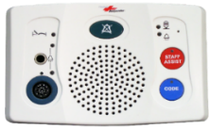
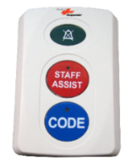
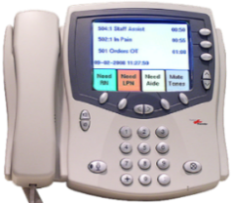
Staff Assist
Corridor Light Display:
Cascading red lights in all 4 segments above the patient’s door.
Tone Type:
Fast Ding
Console will ring immediately.
Local console(s)
Annunciation at Duty
Stations on unit.
To Cancel Call:
Press cancel button
Urgent Call Option: (This is an option to receive all urgent calls from all rooms.)
(Uncheck box to receive urgent calls from your rooms only.)

Slide 12

Code Blue
Corridor Light Display:
Cascading blue lights in all 4 segments above the patient’s door.
Tone Type:
Warble
Console will ring immediately.
Local console(s)
PBX
Annunciation at Duty
Stations on unit.
To Cancel Call:
Press cancel button
Urgent Call Option: (This is an option to receive all urgent calls from all rooms.)
(Uncheck box to receive urgent calls from your rooms only.)

Slide 13
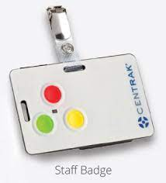

RN Present
CNA Present
Corridor Light Display:
Solid green light in segment 2 above the patient’s door.
Corridor Light Display:
Solid Orange light in segment 3 above the patient’s door.
Tone Type: No tone.
Tone Type: No tone.
PT/OT Present
MD/LIP Present
Corridor Light Display:
Solid White light in segment 3 above the patient’s door.
Corridor Light Display:
Solid Blue light in segment 3 above the patient’s door.
Tone Type: No tone.
Tone Type: No tone.

Slide 14
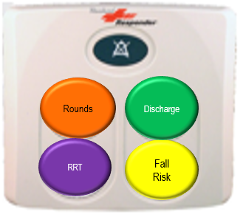
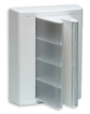
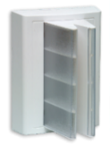
Rounds Workflow:
3 pink solid
2,3 pink solid
1:01 hours.
1:00 hour
To Cancel
Button press
initiates timer
Light Only
Light Only
Toggle on/off NC

