Slide 1


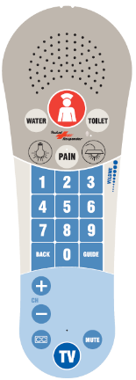

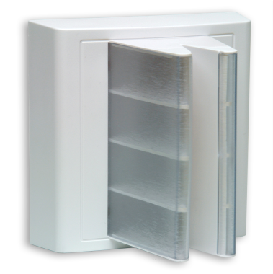
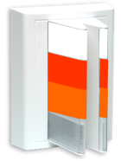
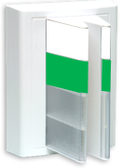
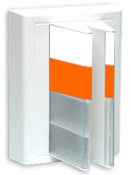
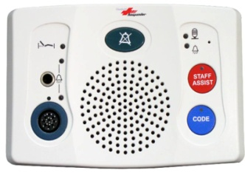
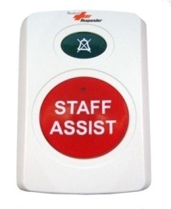
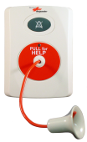
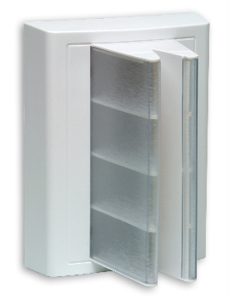
SFI
Pillow Speaker:
Call Priority Name: | Patient | 2. Toilet Assist | 3. In Pain | 4. Water
Tone: | Slow Ding | Slow Ding | Slow Ding | Slow Ding
Send message to: | To Wireless then Console after 1 min | To Wireless then Console after 1 min | To Wireless then Console after 1 min | To Wireless then Console after 1 min
Corridor Light:
Flash
Flash
Flash
Flash
Patient Station
Call Priority Name: | Staff Assist | Code Blue | Patient | Cord out/Bed Out (DIN)/Plug Out (Aux)
Tone: | Fast Ding | Warble | Slow Ding | Medium Ding
Send message to: | Console Immediately | Console Immediately | Console Immediately | To Wireless then Console after 1 min
Corridor Light:
Flash
Strobe
Flash
Flash
2-button Station
Staff
Assist Button
Bathroom
Pull Cord
Feature Bed Receptacle
Call Priority Name: | Toilet/Shower Emergency
Tone: | Fast Ding Dong
Send message to: | Console Immediately
Call Light:
Call Priority Name: | Bed Exit
Tone: | Fast Ding
Send message to: | Console Immediately
Call Light:
Flash
Cascade

Slide 2
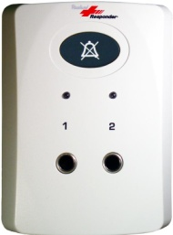
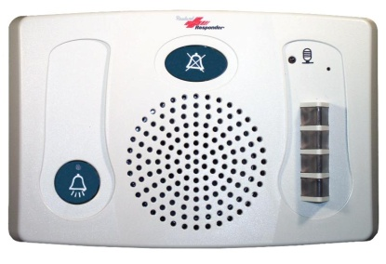
2-JACK
Call Priority Name: | Chair Alarm | Chair Alarm
Tone: | Fast Ding | Fast Ding
Send message to: | Console Immediately | Console Immediately
Call Light:
Cascade
Cascade
Duty Station:
Secondary tone and light indicator for staff assist and code blues.
It provides a call-in push button which allows 2-way audio communication.

